Slide 1
Python - pygame
Kyra Bolster
Soyoung Kim

Slide 2
Table of Contents
Intro to Python
Basic Syntax
Pygame Demo

Slide 3

Intro to Python
Created in the 1980s
First implemented in 1989 by Guido Van Rossum in the Netherlands
Named after "Monty Python's Flying Circus"
Interpreted language
High-level
Dynamically-typed
garbage-collection

Slide 4






Python Uses
Data Science, machine learning, web development, game development, bioinformatics and more.
Well-known programs that use Python:

Slide 5

Intro to Pygame
Pygame is a set of Python modules designed for writing video games
Builds on the SDL library
Free and open-source Python library
Just turned 20 years old
Use pip to install
Pip: python package installer
python -m pip install pygame
“According to their website, “there may also be a few cats, several koalas, dozens of doggos, 3.14 gnomes, and 42 robots” on their team.”
Notes:
They are Small volunteer group
SDL: Simple DirectMedia Layer; designed to provide low level access to audio, keyboard, mouse, joystick, and graphics hardware

Slide 6
Pygame Features
It’s simple and easy
Truly portable
Does not require a GUI to use all functions
Fast response to reported bugs
Small amount of code
Modular
Notes:
Can do more in your game
C code can be 10-20 times faster than python code, and assembly code can be 100x faster
Dont need set up tools
Can be used across various OS’s and devices
Is used to teach kids
Over 660 projects have been published on the pygame websites
You call pygame functions, they don't call your functions. This gives you greater control when using other libraries, and for different types of programs.
Can use from command line to just process images, get joystick input, or play sounds
Often patched within in hour. Not many bug reports these days
extra things like GUI libraries, and effects are developed separately outside of pygame
You can use pieces of pygame separately. Eg different sound library

Slide 7
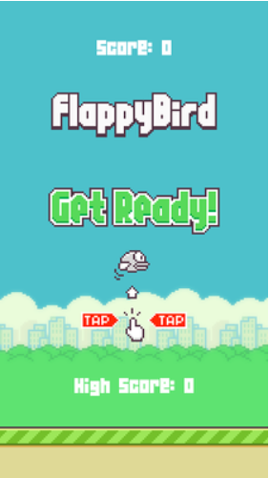
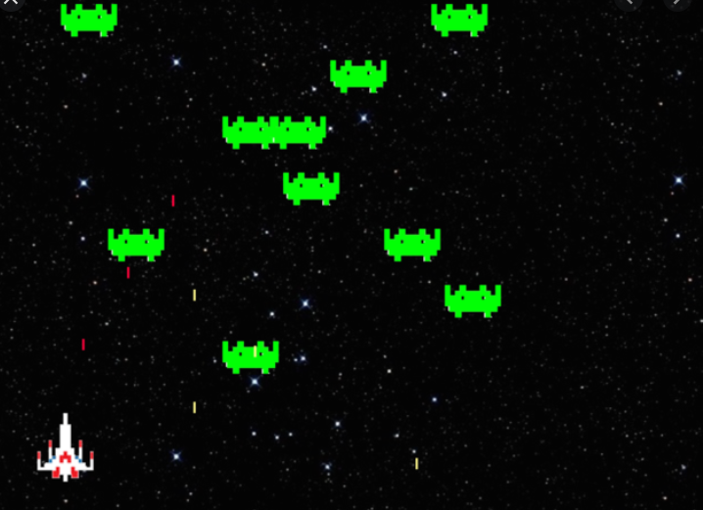
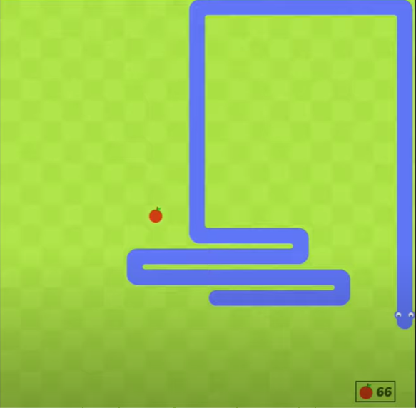
Pygame Examples
https://www.pygame.org/project/5141/7500
https://github.com/AhanM/Space-Invaders
https://www.youtube.com/watch?v=QFvqStqPCRU&t=221s
Notes:
https://www.upgrad.com/blog/pygame-open-source-projects/

Slide 8
Python – Basic Syntax

Slide 9

Number
String
Boolean
a = 100 # Integer
b = ”Hello World” # String
c = True # Boolean
myList = [1, 2, 3, 4] # List
myTuple = (1, 2, 3, ‘a’, ‘b’) # Tuple

Slide 10
If, elif, else
if [boolean expression]:
statement1
statement2
elif [boolean expresion]:
statement1
elif [boolean expresion]:
statement1
else:
statement1
colon :
Indentation

Slide 11
While Loop
while [boolean expression]:
statement1
statement2
...
statementN
colon :
Indentation

Slide 12
For Loop
for x in sequence:
statement1
statement2
...
statementN
colon :
Indentation

Slide 13
Function Defining
def greet(): # def keyword + function name + parameters + :
“““This function displays string””” # Description(optional)
print('Hello World!’) # Indentation
greet() # calling user-defined function
a = greet() # Assign return value to a
print(a) # If the return does not exist, output is None
help(greet) # displays the description string
Help on function greet in module __main__:
greet()
This function displays string

Slide 14
Class Defining
class Person: # Class keyword + class name + :
pass # Placeholder for future code. Nothing happens, No error
class Person :
def __init__(self, name): # Constructor method(2 underscores)
self.name = name
def displayInfo(self, age): # Class method. Self is first argument
print(f“Name: {self.name} Age: {age}”)
p = Person(‘Eric’) # Creating an object of a class
p.name # Access property
p.displayInfo(25) # No need self argument
‘Name: Eric Age: 25’ # Output
Notes:
The pass statement is used as a placeholder for future code.
When the pass statement is executed, nothing happens, but you avoid getting an error when empty code is not allowed.
Empty code is not allowed in loops, function definitions, class definitions, or in if statements.

Slide 15
Module
Any text file with the .py extension containing Python code
import module_name # Import keyword + module name
import module_name as new_name # Rename the imported module
from module_name import func_name # Import specific functions
from module_name import * # Import all functions from the module

Slide 16
Pygame Demo

Slide 17
Resources :
https://docs.python.org/3.9/tutorial/index.html https://www.youtube.com/watch?v=FfWpgLFMI7w https://www.youtube.com/watch?v=QFvqStqPCRU&t=1873s

Slide 18
How it works?
Get player input (mouse, keyboard, etc)
Set position elements on screen
Draw graphics (every seconds)

Slide 19






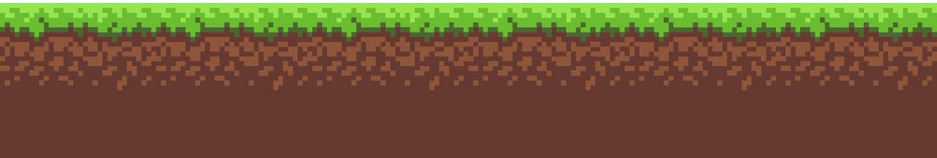
Draw graphic
Canvas
Objects
Back Ground
Draw all every second
User input
Change position

Slide 20
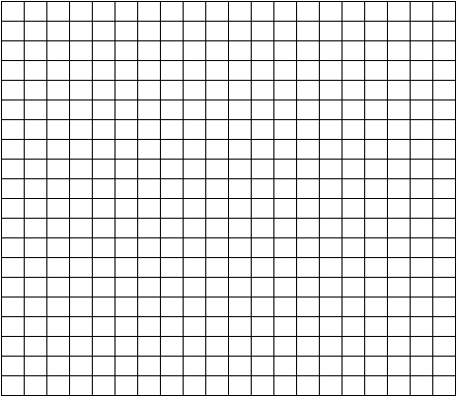
Grid
X position
Y position
Position(14, 6)
Position[ (15, 13), (15, 14), (14, 14), (13, 14), (13, 15) ]
Notes:
We are creating grid to display our elements. Not actual grid, just feel like grid.
Everytime our snake is moving, it can only move certain increment.
And we are going to put our snake using list with different position and direction.
You will see in the demo.

Slide 21
Structure of project
1. Import pygame
2. Initialize pygame (pygame.init())
3. Declare global variable
size(x, y)
screen(pygame.display.set_module(size))
clock(pygame.time.Clock())
objects(classes)
4. Main method(while loop)
{
Processing event
Drawing on the screen
Get user input
}

Slide 22
Demo Time!
Run your visual studio code!

